Slide 1
FP-Growth algorithm
Vasiljevic Vladica,
vv113314m@student.etf.rs

Slide 2
Introduction
Apriori: uses a generate-and-test approach – generates candidate itemsets and tests if they are frequent
  Generation of candidate itemsets is expensive(in both space and time)
  Support counting is expensive
    Subset checking (computationally expensive)
    Multiple Database scans (I/O)
FP-Growth: allows frequent itemset discovery without candidate itemset generation. Two step approach:
  Step 1: Build a compact data structure called the FP-tree
    Built using 2 passes over the data-set.
  Step 2: Extracts frequent itemsets directly from the FP-tree

Slide 3
Step 1: FP-Tree Construction
FP-Tree is constructed using 2 passes over the data-set:
Pass 1:
  Scan data and find support for each item.
  Discard infrequent items.
  Sort frequent items in decreasing order based on their support.
Use this order when building the FP-Tree, so common prefixes can be shared.

Slide 4
Step 1: FP-Tree Construction
Pass 2:
Nodes correspond to items and have a counter
FP-Growth reads 1 transaction at a time and maps it to a path
Fixed order is used, so paths can overlap when transactions share items (when they have the same prfix ).
  In this case, counters are incremented
Pointers are maintained between nodes containing the same item, creating singly linked lists (dotted lines)
  The more paths that overlap, the higher the compression. FP-tree may fit in memory.
Frequent itemsets extracted from the FP-Tree.

Slide 5
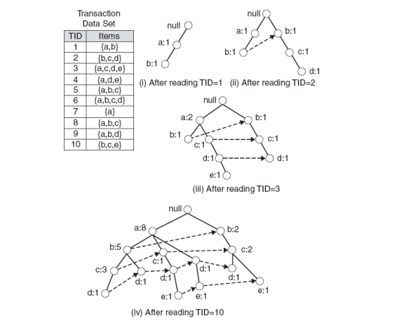
Step 1: FP-Tree Construction (Example)

Slide 6
FP-Tree size
The FP-Tree usually has a smaller size than the uncompressed data - typically many transactions share items (and hence prefixes).
  Best case scenario: all transactions contain the same set of items.
    1 path in the FP-tree
  Worst case scenario: every transaction has a unique set of items (no items in common)
    Size of the FP-tree is at least as large as the original data.
    Storage requirements for the FP-tree are higher - need to store the pointers between the nodes and the counters.
The size of the FP-tree depends on how the items are ordered
Ordering by decreasing support is typically used but it does not always lead to the smallest tree (it's a heuristic).

Slide 7
Step 2: Frequent Itemset Generation
FP-Growth extracts frequent itemsets from the FP-tree.
Bottom-up algorithm - from the leaves towards the root
Divide and conquer: first look for frequent itemsets ending in e, then de, etc. . . then d, then cd, etc. . .
First, extract prefix path sub-trees ending in an item(set). (hint: use the linked lists)

Slide 8
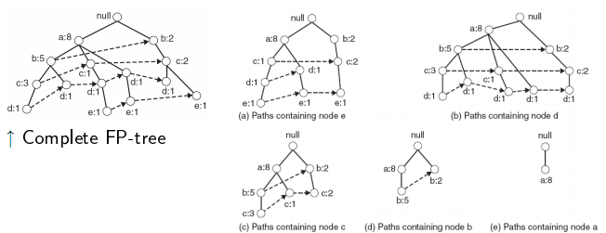
Prefix path sub-trees (Example)

Slide 9
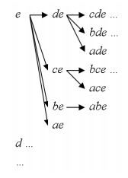
Step 2: Frequent Itemset Generation
Each prefix path sub-tree is processed recursively to extract the frequent itemsets. Solutions are then merged.
  E.g. the prefix path sub-tree for e will be used to extract frequent itemsets ending in e, then in de, ce, be and ae, then in cde, bde, cde, etc.
  Divide and conquer approach

Slide 10
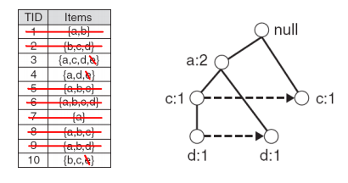
Conditional FP-Tree
The FP-Tree that would be built if we only consider transactions containing a particular itemset (and then removing that itemset from all transactions).
I Example: FP-Tree conditional on e.

Slide 11
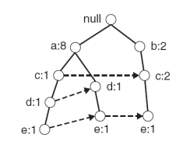
Example
Let minSup = 2 and extract all frequent itemsets containing e.
1. Obtain the prefix path sub-tree for e:

Slide 12
Example
2. Check if e is a frequent item by adding the counts along the linked list (dotted line). If so, extract it.
  Yes, count =3 so {e} is extracted as a frequent itemset.
3. As e is frequent, find frequent itemsets ending in e. i.e. de, ce, be and ae.

Slide 13
Example
4. Use the the conditional FP-tree for e to find frequent itemsets ending in de, ce and ae
  Note that be is not considered as b is not in the conditional FP-tree for e.
I For each of them (e.g. de), find the prefix paths from the conditional tree for e, extract frequent itemsets, generate conditional FP-tree, etc... (recursive)

Slide 14
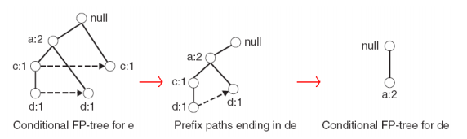
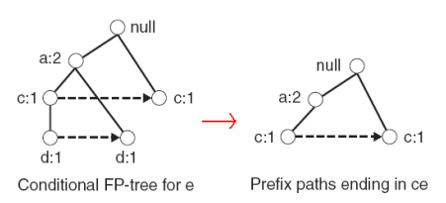
Example
Example: e -> de -> ade ({d,e}, {a,d,e} are found to be frequent)
Example: e -> ce ({c,e} is found to be frequent)

Slide 15
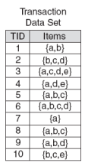
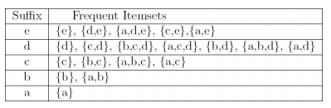
Result
Frequent itemsets found (ordered by sufix and order in which they are found):

Slide 16
Discusion
Advantages of FP-Growth
  only 2 passes over data-set
  “compresses” data-set
  no candidate generation
  much faster than Apriori
Disadvantages of FP-Growth
  FP-Tree may not fit in memory!!
  FP-Tree is expensive to build

Slide 17
References
[1] Pang-Ning Tan, Michael Steinbach, Vipin Kumar:Introduction to Data Mining, Addison-Wesley
www.wikipedia.org

